Slide 1

FinSight: Explainable Credit Risk Analytics and Loan Decision Support System
DATA SCIENCE (24AD3107) Project Review-1
17/09/2026
 | Under the Guidance of Ms. Prathusha Assistant Professor, Department of Computer Science and Engineering, KLH CSE Bowrampet Campus
Team Members M. Manasvini - 2420030475 N. Sreeja - 2420030267 M. Sahasra – 2420030459 S. Sreeja Reddy - 2420030548

Slide 2

Outline of Project Work
Focus
Introduction
Literature Survey
Challenges
Research Objectives
Conclusion & Future Work
References
Publications Details

Slide 3
Problem Statement
Credit risk assessment is an important process for financial institutions to determine the likelihood of a borrower repaying a loan. Traditional credit assessment methods often depend on predefined rules and limited financial information, which may not capture complex patterns in applicant data. Machine Learning can analyze multiple applicant characteristics and identify patterns associated with credit risk, but many ML-based systems provide predictions without clearly explaining the reasons behind those decisions. This lack of transparency can make it difficult for users to understand and interpret the results. Therefore, there is a need for an integrated system that combines credit-risk prediction, risk scoring, explainable AI, cloud-based data analytics, and interactive visualization. FinSight aims to address this problem by developing a cloud-enabled credit-risk analytics system that predicts credit risk, generates an understandable risk score, identifies important factors influencing predictions using SHAP, and presents the results through an interactive dashboard.

Slide 4
Objectives
Preprocess and analyze credit applicant data for identifying important risk patterns.
Develop and compare ML models for credit-risk classification.
Evaluate models using Accuracy, Precision, Recall, F1-score and ROC-AUC.
Develop a probability-based risk scoring system for applicants.
Apply SHAP Explainable AI to identify factors influencing predictions.
Use AWS S3, Glue and Athena for cloud-based data storage and analytics.
Develop a Flask-based interactive dashboard for analytics and risk assessment.

Slide 5
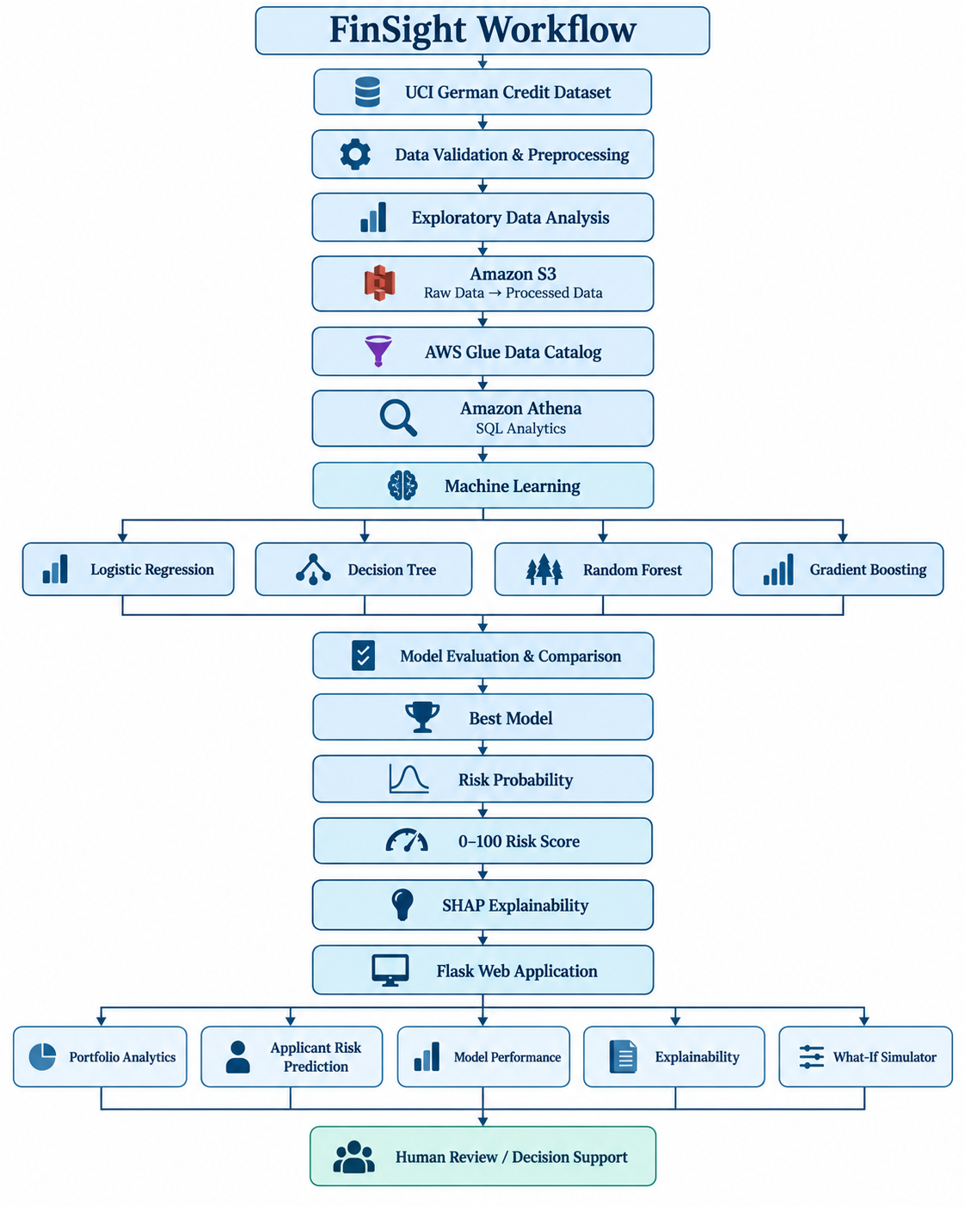
PROJECT DESIGN

Slide 6
Literature Survey
Authors | Title of the Paper | Methodology | Inferences | Limitation/Future work
Niklas Bussmann, Paolo Giudici, Dimitri Marinelli, Jochen Papenbrock | “Explainable Machine Learning in Credit Risk Management” | Applied Machine Learning for credit-risk assessment. Used Shapley values (SHAP) to explain model predictions. | ML can improve credit-risk assessment. Explainability helps users understand the reasons behind predictions. | Explainability and transparency still require further development for practical financial applications.
Wei Wang, Christopher Lesner, Alexander Ran, Marko Rukonic, Jason Xue, Eric Shiu | “Using Small Business Banking Data for Explainable Credit Risk Scoring” | Used XGBoost for credit-risk scoring. Applied SHAP to explain individual credit-risk predictions. | ML can be used effectively for credit-risk scoring. SHAP provides understandable explanations for model decisions. | Focuses on small-business banking data; broader datasets and applications can be explored.
Si Shi, Rita Tse, Wuman Luo, Stefano D’Addona, Giovanni Pau et al. | “Machine learning-driven credit risk: a systemic review” | Reviewed statistical, Machine Learning and Deep Learning techniques for credit risk. Compared challenges related to datasets, performance and model transparency. | ML provides several approaches for credit-risk prediction. Data quality and model interpretability remain important challenges. | Highlights the need for further research into ML methods and their limitations.

Slide 7
Dataset
Dataset — German Credit Data
Source: UCI Machine Learning Repository
Domain: Credit Risk
Records: 1,000 applicants
Features: 20 input attributes
Target: Good / Bad Credit Risk
Contains both numerical and categorical attributes
Example Attributes
Credit amount
Duration
Credit history
Savings
Employment
Age
Housing
Loan purpose

Slide 8
Problem Gap Identification
Many basic credit-risk systems focus mainly on prediction accuracy.
Prediction alone does not explain why an applicant receives a particular risk classification.
Limited integration between credit-risk ML, explainability and interactive decision support in simple student prototypes.
Different classification errors can have different consequences in credit-risk assessment.
Many implementations lack an integrated cloud analytics layer.
There is scope for combining risk prediction + risk scoring + SHAP explanations + cloud analytics within one system.
Gap addressed by FinSight
FinSight integrates predictive ML, explainability, risk scoring, cloud analytics and interactive visualization into a single educational decision-support system

Slide 9
Innovation, Creativity, and Novelty
1. Explainable Credit Risk
Uses SHAP to show the factors influencing individual predictions.
2. Risk Score
Converts model probability into an understandable 0–100 risk score.
3. What-If Risk Analysis
Allows selected applicant attributes to be changed and shows how the model's predicted risk changes.
4. Cost-Sensitive Evaluation
Considers the different consequences of misclassifying risky and non-risky applicants.
5. Cloud-Based Analytics
Uses:
Amazon S3 → AWS Glue → Amazon Athena
for data storage, cataloging and SQL analysis.
6. Integrated Web Application
Flask combines analytics, prediction, explainability and model evaluation into one interface

Slide 10
Feasibility and Project Plan
Technical Feasibility
Uses established Python ML libraries.
Dataset is publicly available and manageable in size.
Flask provides a lightweight web framework.
AWS services provide scalable cloud data management.
Operational Feasibility
Simple browser-based interface.
Risk predictions are accompanied by explanations.
No specialized hardware is required.
Economic Feasibility
Primarily uses open-source Python libraries.
Small academic dataset keeps cloud resource requirements limited.
Suitable for low-cost prototype implementation.

Slide 11
Project Plan
Phase | Topics | Work
Phase 1 | Setup | Dataset, validation, S3
Phase 2 | Data | EDA, preprocessing, Glue, Athena
Phase 3 | ML | Train and compare 4 models
Phase 4 | XAI | Risk score + SHAP
Phase 5 | Application | Flask dashboard
Phase 6 | Integration | AWS integration + testing
Phase 7 | Finalization | QA, documentation & presentation

